Slide 1



Predicting Medication Errors at Apollo Hospitals
Presentation by : Amrata Agrawal, Harsh Upadhyay, Jeya Sri R, & Sharan Sivakumar

Slide 2
Participants Introduction
Team Apollo
Team IIMB
Mr. Gaurav Loria (Group Chief Quality Officer and VP Operations)
Dr. Sanjeev Sharma - Clinical Pharmacologist
Dr. Mohammed Ziauddin - Clinical Pharmacologist
Dr Sanjay Dalsania - Regional Head Quality
Mr Balaji V - Regional Head Quality
Ms Yogamaya Nayak - Group Quality and Operations
Dr. U Dinesh Kumar (Professor - Decision Sciences & Programme Director of Business Analytics & Intelligence)
Dr. Haritha Saranga - Professor -Production & Operations Management & Our Project Mentor
Ms. Pooja Balasubramanya – Program Manager
Business Analytics & Intelligence – Batch 11 (Students)
Amrata Agrawal
Harsh Upadhyay
Jeya Sri R
Sharan Sivakumar

Slide 3

Agenda
Project Data Analytics Journey
Business Issue Understanding Data Understanding & Preparation Exploratory Analysis
Data Modelling & DSS* Demonstration
Conceptual Model Logical Model Physical Model Demonstration
Conclusion
DSS Benefits DSS Caveats Future Recommendations
* DSS – Decision Support System

Slide 4
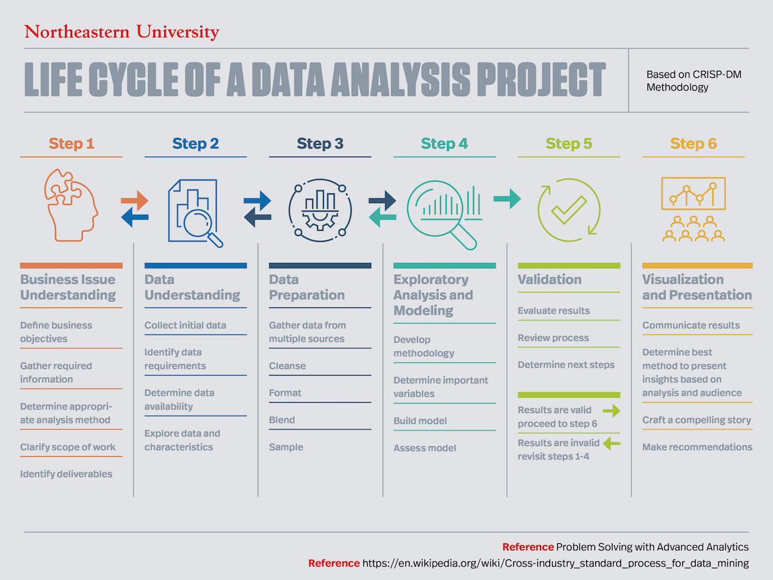
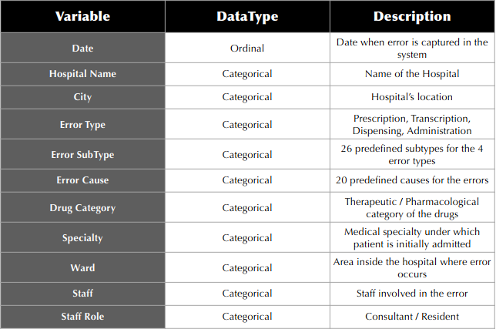
Business Issue Understanding
Define business objective
Employing data-driven decision-making techniques to effectively minimize the number of medication errors and ultimately help save lives.
Gather required information
36 Hospitals
8 Group-A, 10 Group-B and 18 Group-C
Period: 2017-2019
Data: Error Occurrence Information
Different Hospitals’ Error Metadata
6 Hospitals (Focus Hospitals)
Delhi, Ahmedabad, Jubilee Hills, Indore, Lucknow & Chennai Main
Additional Data : Bed Count & Monthly Discharges (for comparing hospitals)
1 Hospitals (Jubilee Hills)
Focus hospital for prototype solution implementation
Notes:
2 min

Slide 5
Data Understanding & Preparation
Explore Data Characteristics
What (types of errors, kind of drugs),
When (time of error occurrence),
Where (ward / specialty), and
Whom & How (staff) factors contributed to these errors
Initial Data Cleaning & Formatting
Erroneous Date Formatting (Interchange of MM and DD)
Missing & Junk Data (Record missing in multiple columns)
Data Duplication (Not mutually exclusive)
Data Mismatch (Descriptions of errors were given, instead of the predefined codes)
Notes:
1.5 min

Slide 6
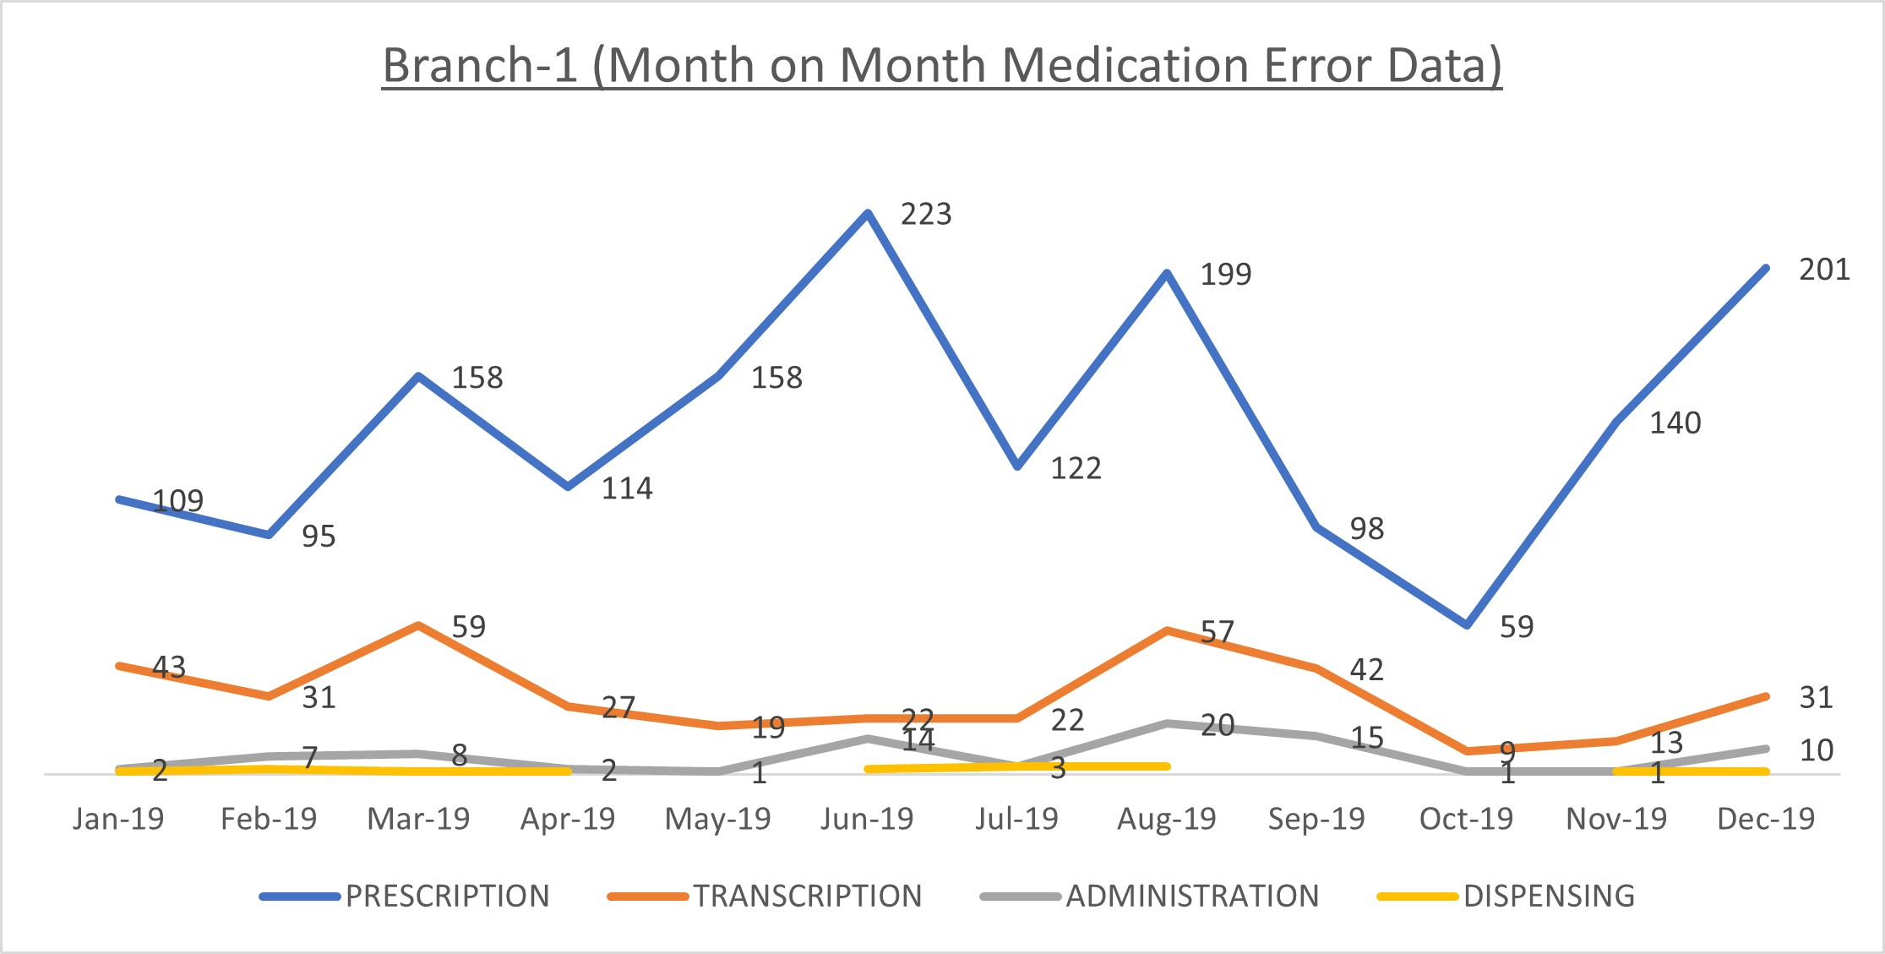
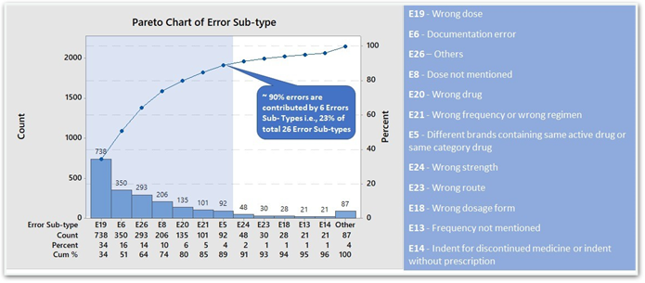
Exploratory Analysis – 6 Focus Hospitals (Level-1)
Determine Important Factors
Error Type: Prescription errors accounted for a majority of all errors occurred (~80%) followed by transcription errors (~17%)
Error Sub-type : Wrong Dose, Doc. Errors, Dose not mentioned, Wrong Drug, Wrong Frequency & Different brands containing same active drug are the top 7 sub-type errors contributed ~90% of errors
Error Cause: 77% of all errors are because of Forgetfulness/Hurry (P9 - Doctor Hurry & A4 - Nurse Hurry)
Drug Category: 33% of all medical errors stem from just three drug categories namely, Antibiotics, Cardio-Vascular Drugs & Antihypertensives
Criticality: 97% errors are not related with High Alert Medication
Notes:
3.5 min

Slide 7
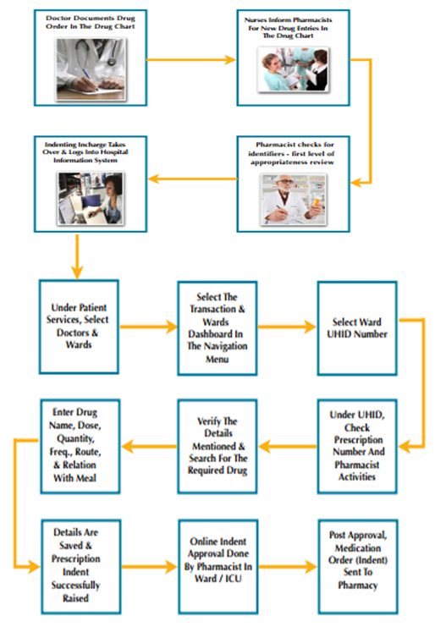
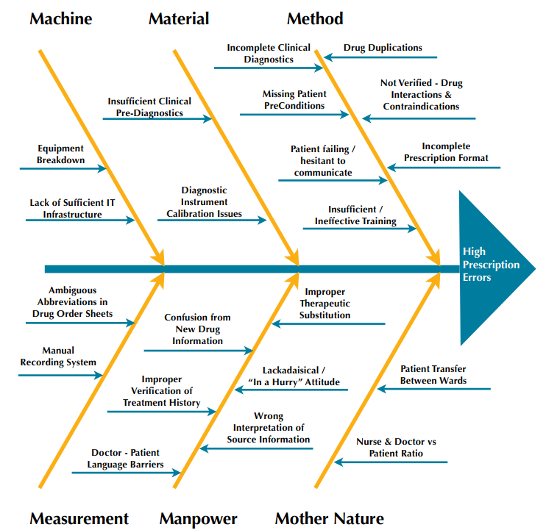
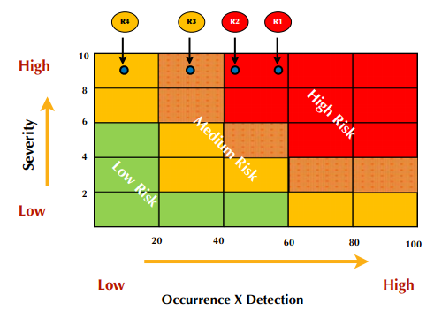
Process Door Analysis & Risk Assessment
Detailed Process Understanding
Fishbone Diagram
Risk Assessment Exercise & Priority Matrix
FMEA
+
R1: Drug Interactions & Contraindications Not Verified
R2: Drug Duplications
R3: Improper Therapeutic Substitution
R4: Confusion From New Drug Information
Notes:
2 min

Slide 8
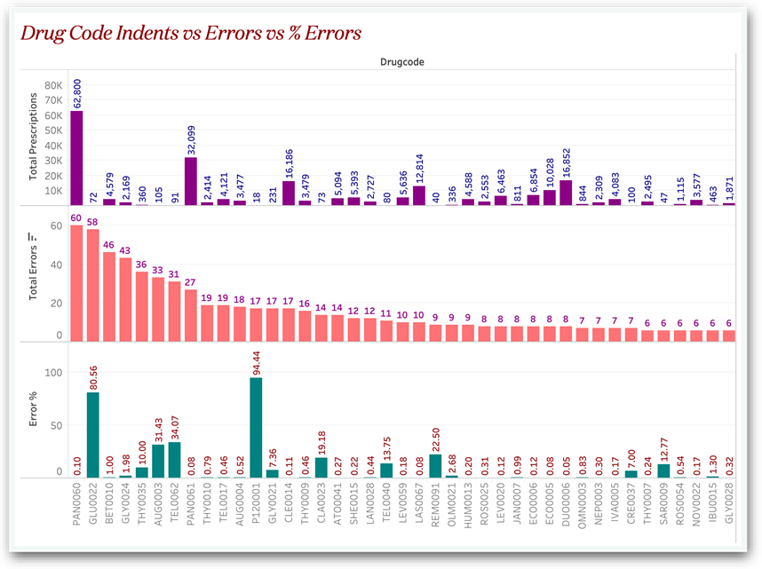
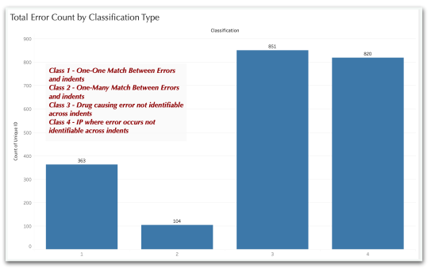
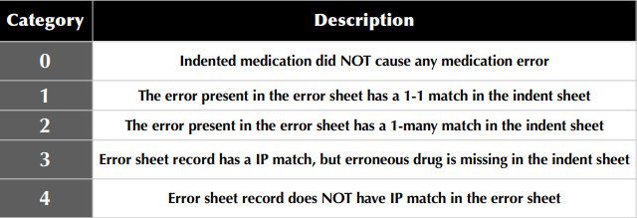
Exploratory Analysis – Jubilee Hills Hospital (Level-2)
Indenting Data Insights from Jubilee Hills
The insights were obtained across features like Drugs, Wards, Generic Names & Medicine type
Compared 1.5 million individual indented drugs with the 1395 drug errors of the same time interval
12 drugs (out of 8683 drugs) which are prescribed more than 10,000 times in the year, and they account for ~20% of all the indents.
48 drugs (out of 8683 drugs) are accountable for ~50% of the medication errors
Mapping the Errors With the Indents
Treatment of Error Categories 2,3 & 4 : the absorption of category 2 errors, imputation of category 3 errors, and the deletion of category 4 errors resulted in a dataset having 1395 erroneous indents (positive class) and ~15 lakh non erroneous indents (negative class)
Notes:
4 min

Slide 9

Modelling – Conceptual Model
Feature Engineering
Available features for analysis
Drug Code, Medicine Name, Generic Name (non-standardized)
Ward name
Error/ Non-error flags
Error type
Features required for Basic Predictive Modelling
Features required for a
Basic Decision Support System
Generic Name (Standardized)
Pharmacological drug class
Drug type (Capsules/ Syrup etc.)
Patient demographics
Patient pre-condition, current illness
Patient length of stay
Time of error observation
Prescription details – dosage, frequency
Correct medication for the error happened
Generic Name (Standardized)
Pharmacological drug class
Drug type (Capsules/ Syrup etc.)
Drug allergy information
Drug contraindication
Frequently prescribed drug combinations
Ward specific - frequently prescribed drug combinations
Drug caution information
Drug substitutes
Currently not available/ Incorrect data
Currently not available BUT CAN BE SOURCED

Slide 10

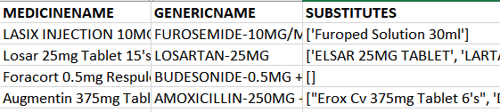

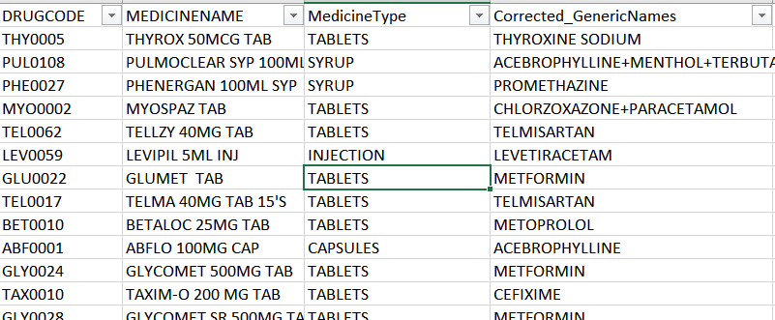


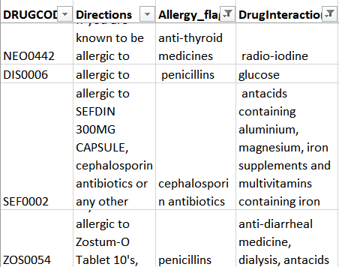
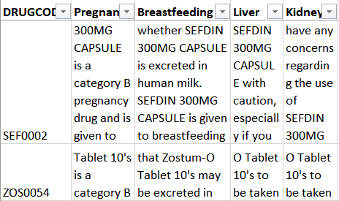
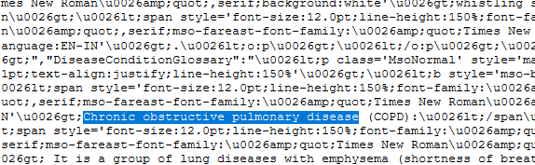
Modelling – Logical Model
Database Creation from Web Sources
INPUT – Web sources
TEXT MINING PROCESSES
OUTPUT - Database
Data Scraping
Entity Recognition
HTML Parsing
Term Frequency Analysis for Spelling Correction
Content Tagging
Noun Phrase Extraction
Sentiment Analysis
Content Grouping
Sample Input Data
POS Tagging
Information Retrieval
Regular Expressions to Filter Content
Mapping Standardized Content

Slide 11
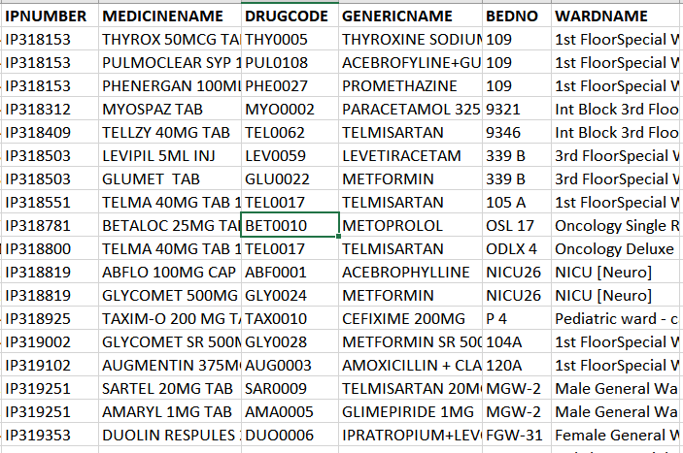
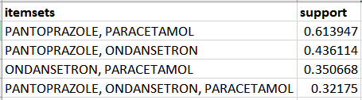
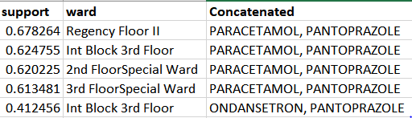
Modelling – Logical Model
Database Creation from Indent data
INPUT – Indents
ASSOCIATION RULE MINING PROCESS
OUTPUT - Database
Exploratory Data Analysis (EDA)
Apriori Algorithm
(Overall Indents)
Apriori Algorithm
(Ward specific)

Slide 12
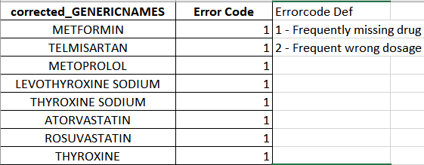
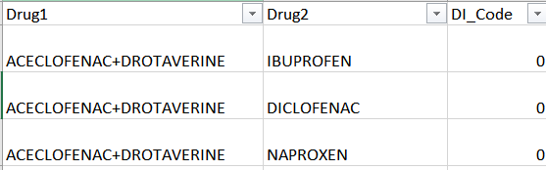
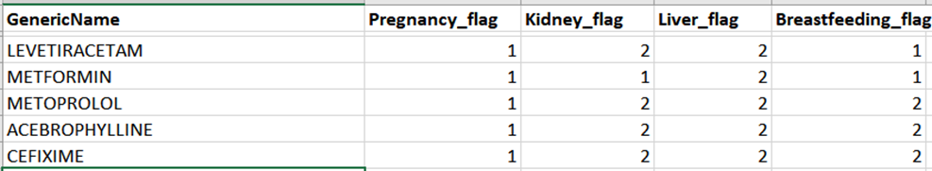
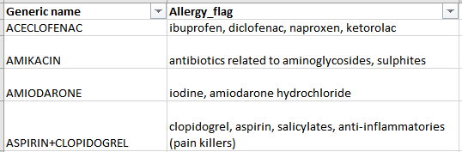
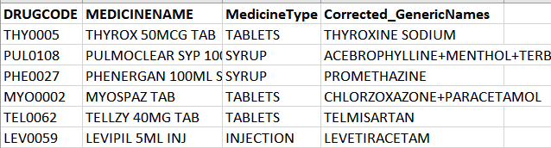
Modelling – Physical Model
Database to Knowledge base
EDA & Frequent sets
Drug Allergy & Contraindication
Drug Caution & Active Ingredients
DATABASE
Pattern Analysis
Decomposing Existing
N:N Relationships
Creating New
N:N Relationships
Encoding
Labels & Context
Generating
Business Rules
KNOWLEDGE BASE

Slide 13
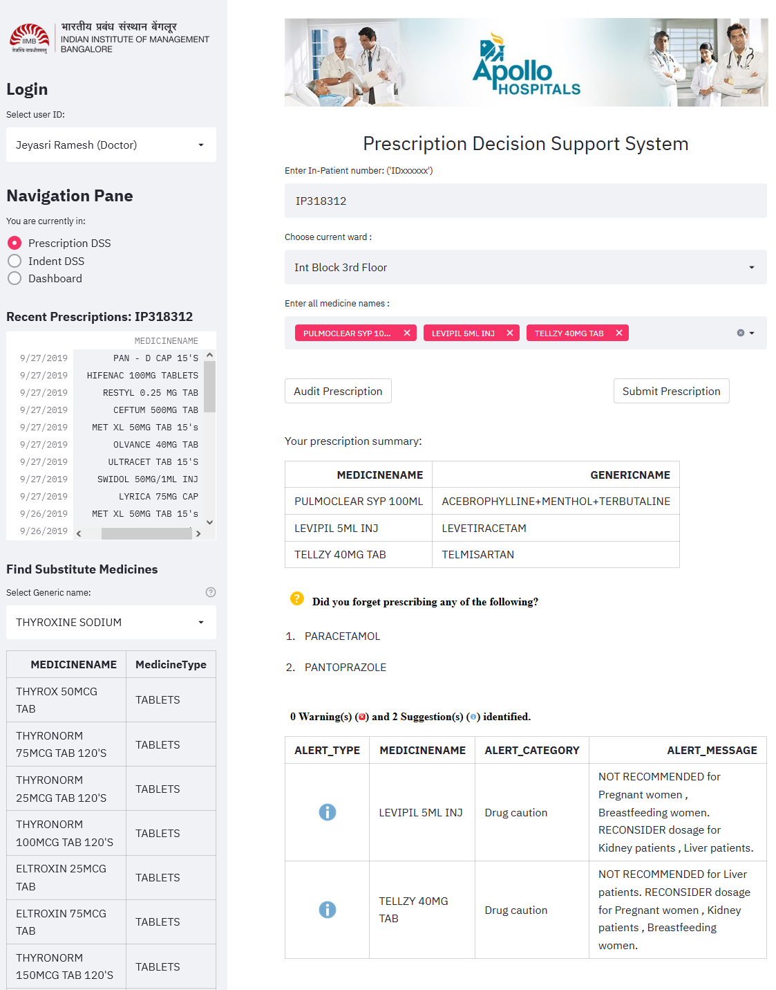
Modelling – DSS Demonstration
Business Rules & Demo
Order of execution | Business Rule | Level of Analysis
1 | Prioritize frequently missed drugs and potential incorrect drug dosage alerts | Prescription level & Indent level
2 | Identify missing drugs in drug sheet | Prescription level & Indent level
3 | Identify therapeutic duplication & drug overdose | Prescription level & Indent level
4 | Identify drug contraindication | Prescription level & Indent level
5 | Remind drug caution & drug allergies | Prescription level

Slide 14
DSS Benefits & Caveats
Benefits
Caveats
DSS is scientific & uses data as its backbone for operation.
Quality team can exercise more control over the medication process.
Monitor each indenting user separately.
Understand drug-level insights better.
Data Traceability means heightened accountability for future errors.
Robust system helps save time & improve productivity.
Stepping stone for bigger AI & ML projects in the future.
Biggest impact – Potential To Save Lives Every Day.
Uses drug-level information to be the prima facie contributor to errors. In reality, there are more factors, as explored.
List of drugs not 100% exhaustive, since there could still be drugs not featured in the scraped data and the indented data.
System assumes the trustworthiness & authenticity of data in the Apollo Pharmacy website.
Need for periodic updates to keep the system informed of new drugs, indenting patterns, to maintain relevancy.
The process is unique to one hospital unit, and is cannot be instantly scaled up. Standardised data collection would help minimise the pre processing, to have a solution which is useable across the board.

Slide 15
Sample Extra Features to be Collected
Variable / Feature | Description | Rationale
Patient_Age | Age of the patient | For drug dosage calculations
Patient_Height | Height of the patient | For drug dosage calculations
Patient_Weight | Weight of the patient | For drug dosage calculations
Patient_Origin | State / city of origin | To check for language barriers
Patient_Specialty | Chief complaint specialty | For error area classification
Med_Name_Old | Original Prescribed Medicine | For error tracing in substitutions
Dosage_Old | Original Prescribed Dosage | For error tracing in substitutions
Med_Name_New | Changed Medicine Name | New replaced drug’s data
Dosage_New | Changed Medicine Dosage | New replaced drug’s data
Ward_Bed_Count | Size of the ward | For caregiver vs patient ratios
Ward_Bed_Position | Position of bed in the ward | Relative position to nurse station
Ward_Percent_Occupancy | % Occupancy | For caregiver vs patient ratios
ICU_Bed_Count | Size of the ICU | For caregiver vs patient ratios
Variable / Feature | Description | Rationale
ICU_Bed_Position | Position of bed in the ICU | Relative position to nurse station
ICU_Percent_Occupancy | % Occupancy | For caregiver vs patient ratios
Nurse_Join_Date | Date of Joining of Apollo | For checking familiarity with SOPs
Nurse_Prior_Exp | Prior Experience | Error Process Tracing
Nurse_Shift_Time_In | When nurse begins duty | Shift timings & duration vs Error
Nurse_Shift_Time_Out | When nurse ends duty | Shift timings & duration vs Error
Nurse_Shift_Type | Normal vs Extended Shifts | Shift timings & duration vs Error
Nurse_Ward_Info | Nurse’s ward responsibility | For caregiver vs patient ratios
Nurse_Age | Age of the Nurse | Error Process Tracing
Doc_Join_Date | Date of Joining of Apollo | For checking familiarity with SOPs
Doc_Prior_Exp | Prior Experience | Error Process Tracing
Doc_Shift_Time_In | When doctor begins duty | Shift timings & duration vs Error
Doc_Shift_Time_Out | When doctor ends duty | Shift timings & duration vs Error

Slide 16
Recommendations
This DSS is developed to assist medical professionals only. Their medical expertise & discretion will still hold much higher preference.
Integration with patients’ data will further expand functionality.
It is essential for Apollo Hospitals to collect data across extra features to get a more holistic reasoning behind medication errors.
More features mean more insights; more insights mean more power to the DSS, and more power to the DSS means better prevention of medication errors.
It is recommended for Apollo Hospitals to create, maintain and nourish their data pipelines constantly, not just for medications, but across all processes critical to service quality.
This can open doors for several advanced AI-ML solutions, providing Apollo Hospitals with enhanced capabilities to continue their mission - achieving and maintaining excellence in healthcare for the benefit of humanity.

Slide 18
Annexure

Slide 19
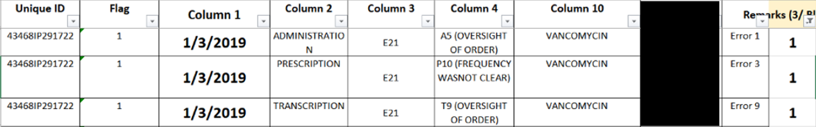
Error Code 1 → Exact Match
Error Sheet
Indent Sheet

Slide 20
Error Code 2 → Multiple Match
Error Sheet
Indent Sheet

Slide 21
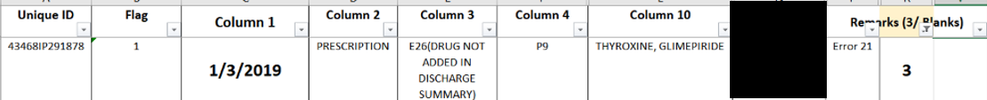
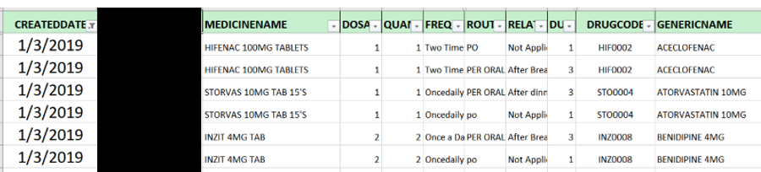
Error Code 3 → Drug Missing in Indent
Error Sheet
Indent Sheet

Slide 22
Error Code 4 → Patient Missing in Indent
Error Sheet
Indent Sheet
Missing

